Slide 1




















Graph Attention AutoEncoder (GATE) – Salehi and Davulcu, 2019
$$N×N$$
Encoder
Decoder
$$A$$
$$N×h$$
$$N×q$$
$$N×h$$
$$N×p$$
$$H_{1}$$
$$Z$$
$${\hat{H}}_{1}$$
$$\hat{X}$$
$$GAT(H_{m−1},A)$$
$$GAT({\hat{H}}_{2},A)$$
$$GAT({\hat{H}}_{1},A)$$
$$GAT(X,A)$$
…
…
$$X$$
$$N×N$$
$$\hat{A}$$
$$N×p$$
Dot Product Decoder $σ(ZZ^{T})$
$$Loss=BCE\left(A, \hat{A}\right)+γ MSE(X, \hat{X})$$
Salehi, Amin, and Hasan Davulcu. "Graph attention auto-encoders." arXiv preprint arXiv:1905.10715 (2019).

Slide 2








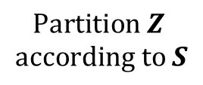

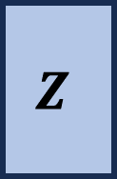






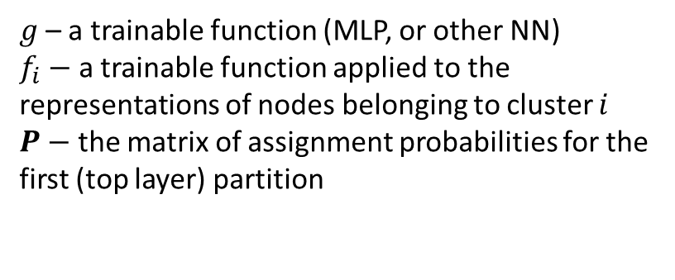













Top-down Classification
$g$– a trainable function (MLP, or other NN)
$f_{i}−$ a trainable function applied to the representations of nodes belonging to cluster $i$
$P−$ the matrix of assignment probabilities for the first (top layer) partition
$$N×k$$
$$P$$
$$S$$
$$argmax$$
$$GATE(X, A)$$
$$Softmax (H)$$
$$N×q$$
$$N×k$$
$$Z$$
$$g(Z)$$
$$H$$
$$Z_{1}$$
$$f_{1}(Z_{1})$$
$$Q_{1}$$
$$SM (Q_{1})$$
$$P_{1}$$
$$Partition Z$$
$$according to S$$
$$Z_{2}$$
$$f_{2}(Z_{2})$$
$$Q_{2}$$
$$SM (Q_{2})$$
$$P_{2}$$
$$⋮$$
$$⋮$$
$$Z_{k}$$
$$f_{k}(Z_{k})$$
$$Q_{k}$$
$$SM (Q_{k})$$
$$P_{k}$$
$$H_{i}∈ ℝ^{|c_{k}|×k}$$
Salehi, Amin, and Hasan Davulcu. "Graph attention auto-encoders." arXiv preprint arXiv:1905.10715 (2019).

